Slide 1


Slide 2

Home trainingcourse placement about contact join now

Slide 3


Slide 4


Slide 5
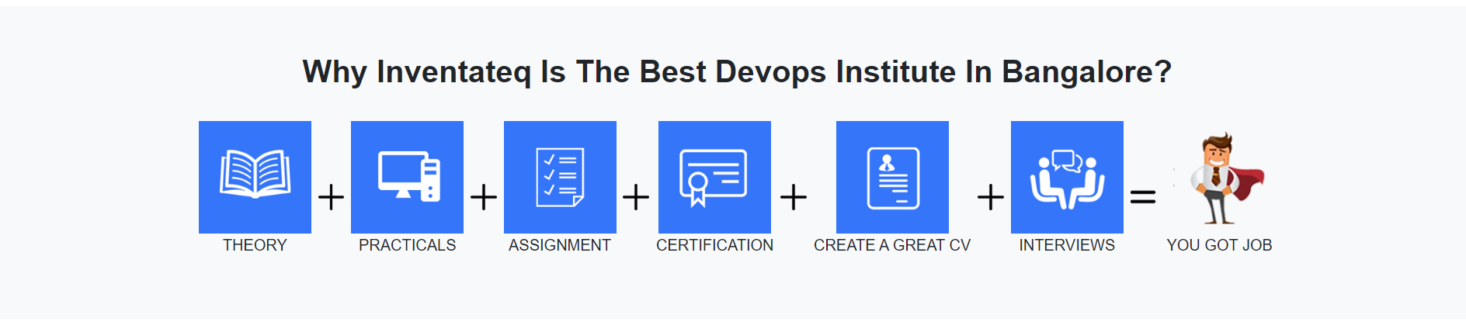

Slide 6
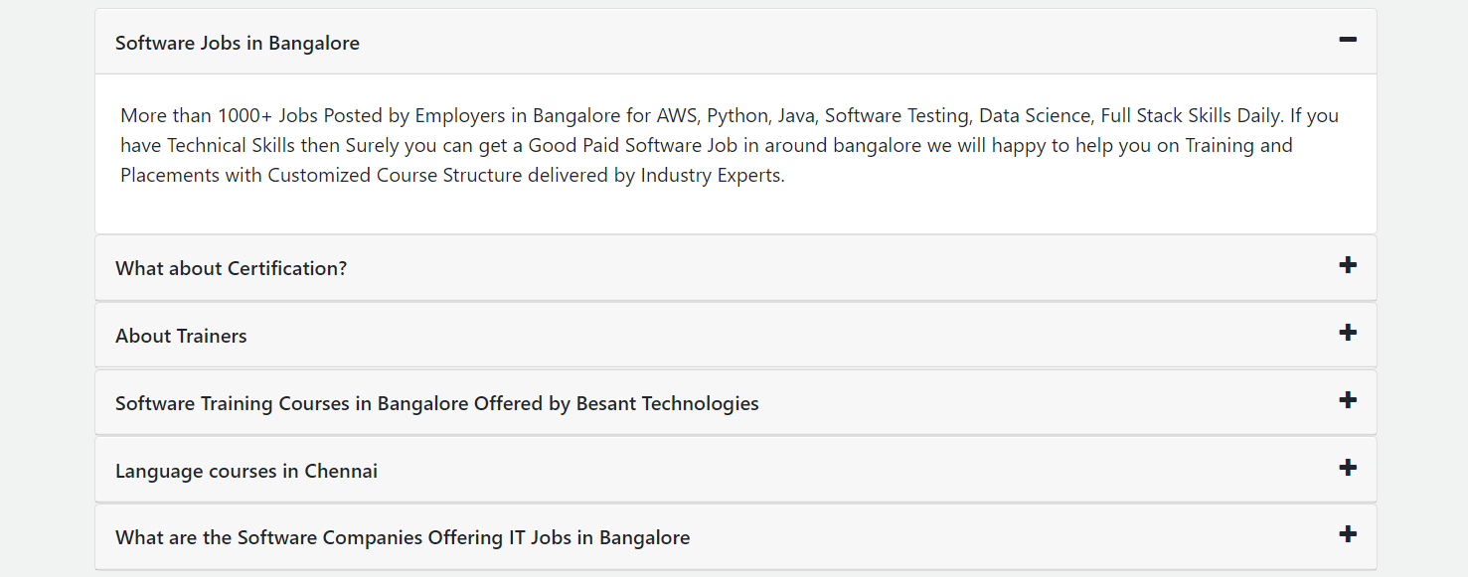

Slide 7
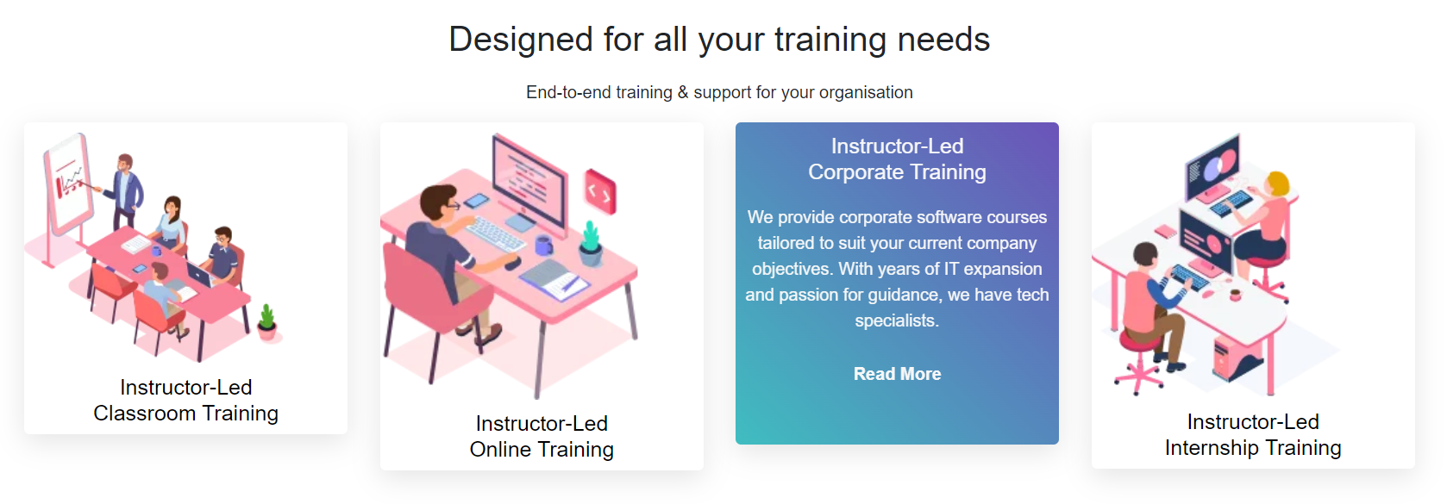

Slide 8


Slide 9


Slide 10
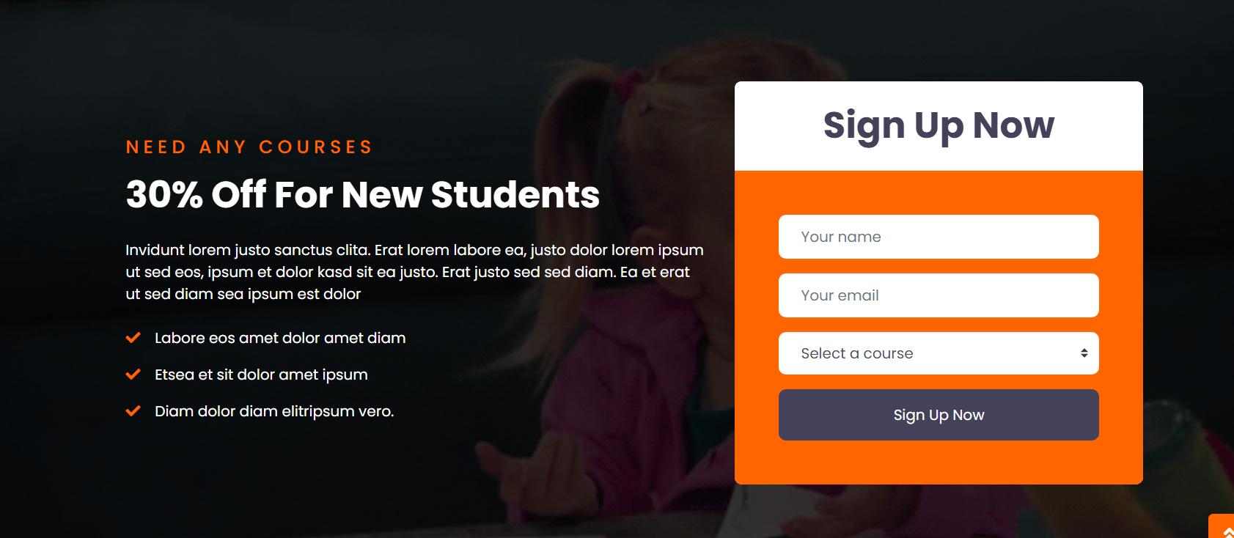

Slide 11


Slide 12


Slide 13
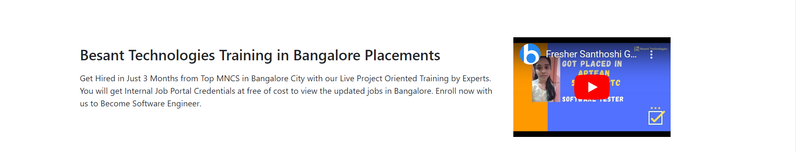
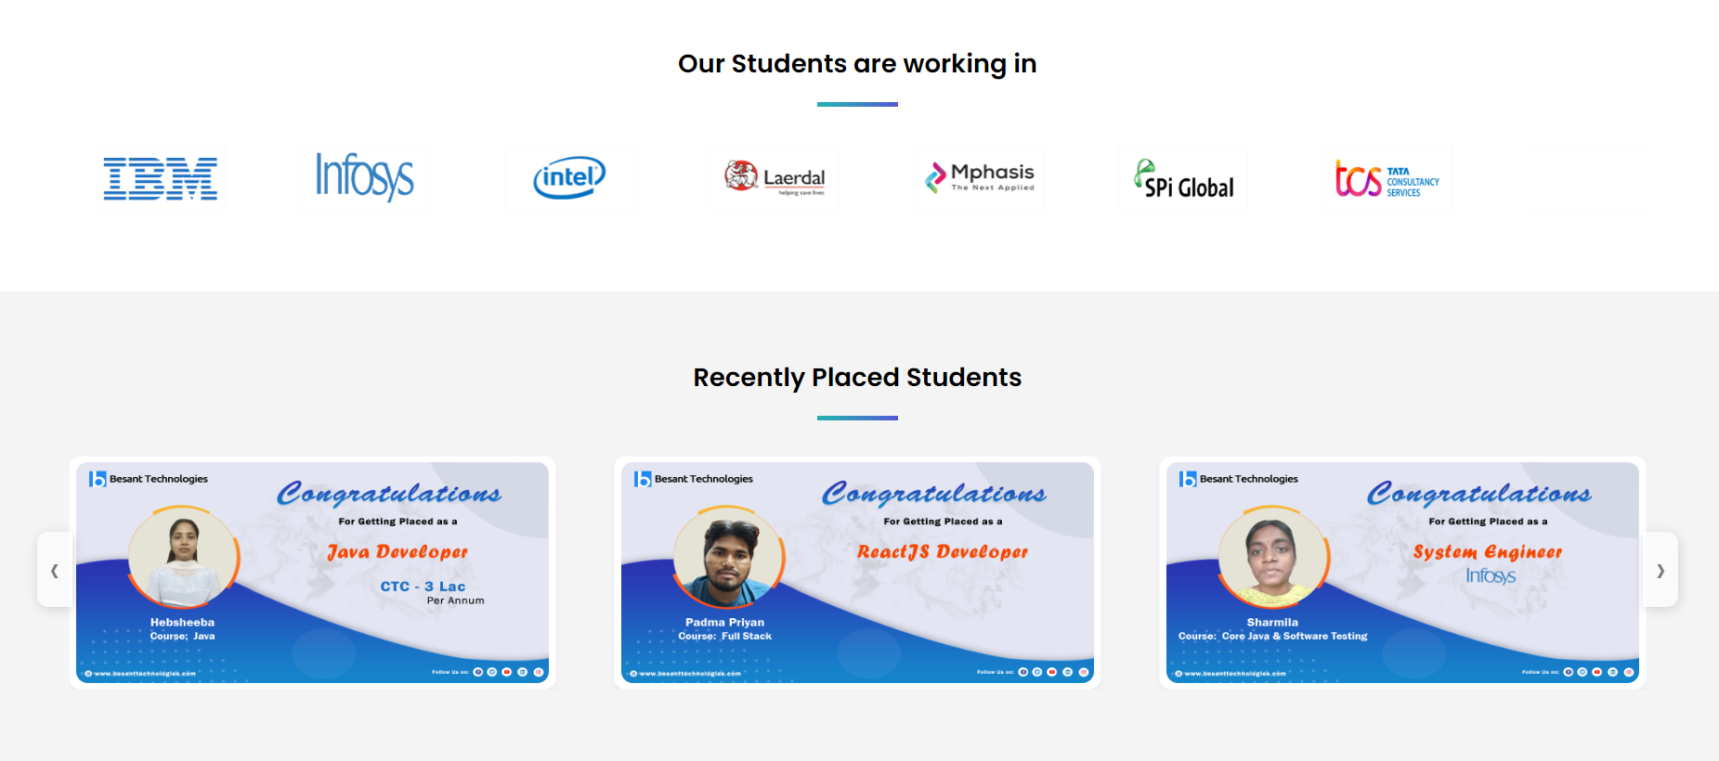

Slide 14
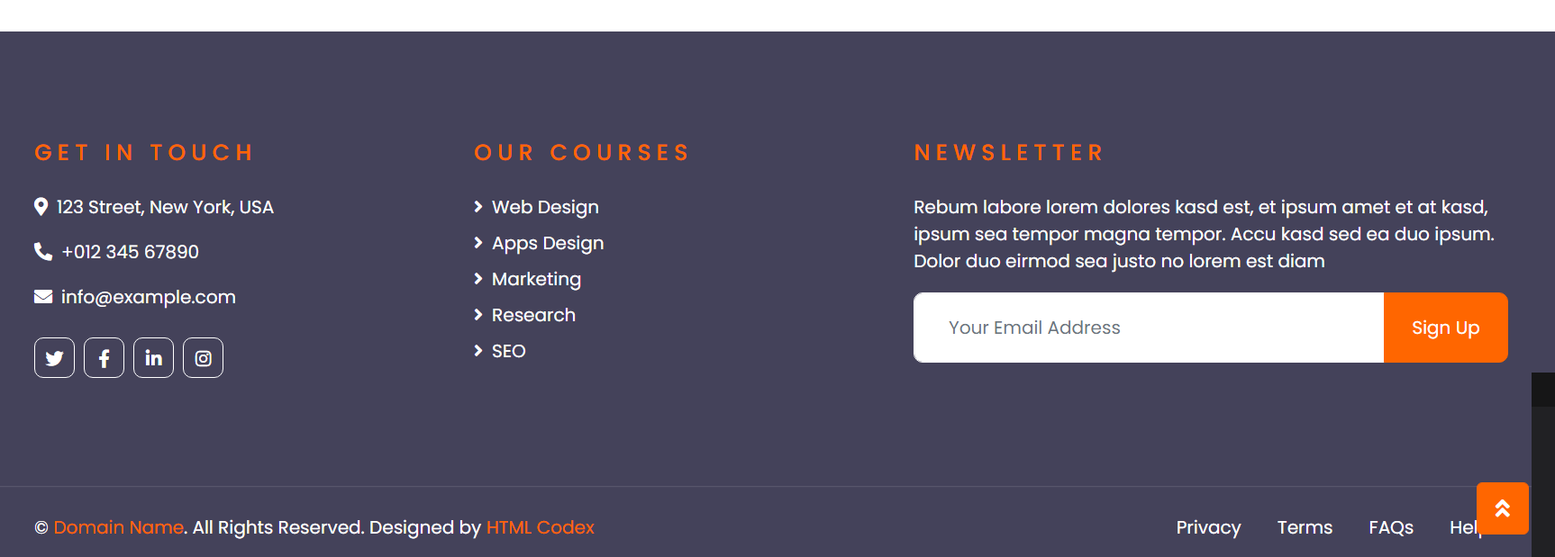

Slide 15
Training courses

Slide 16


Slide 17
Course
Redirect tohttps://www.trainingbangalore.in/big-data-masters-program-training-in-bangalore.html new page

Slide 18
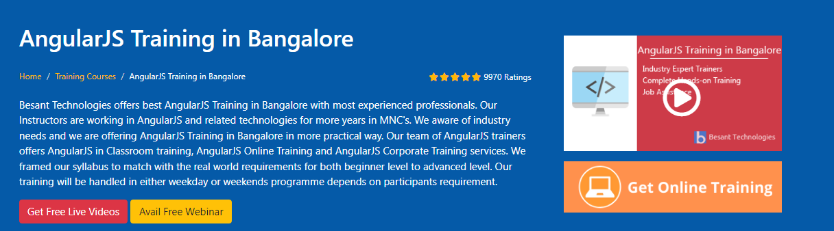
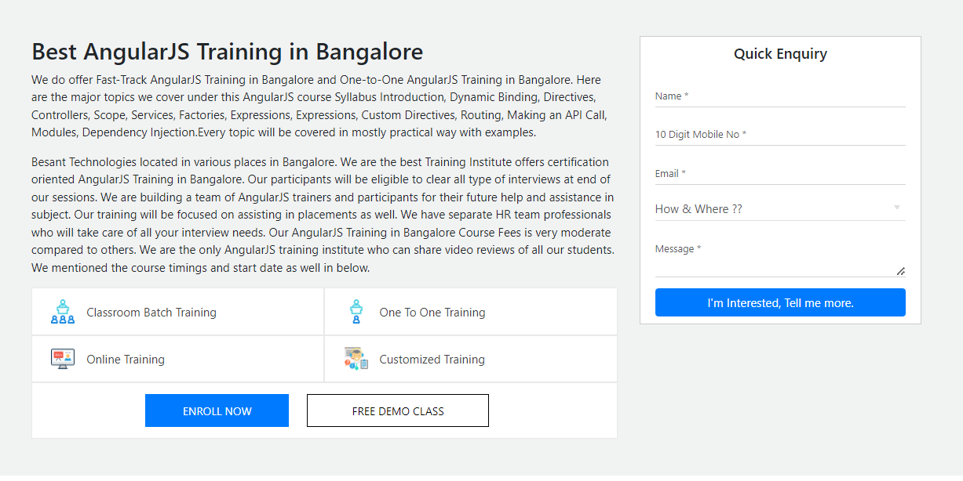

Slide 19
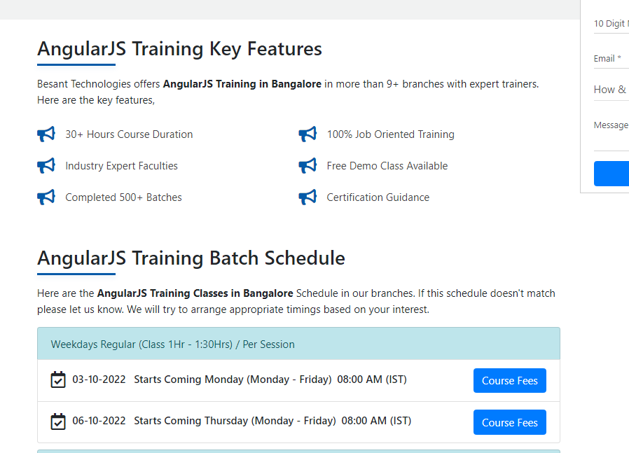

Slide 20
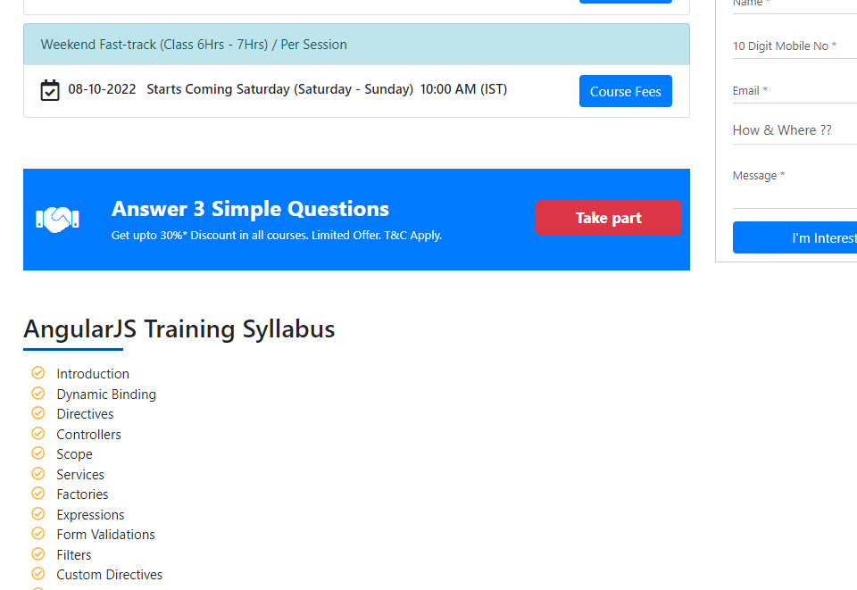

Slide 21
About Us
Same design from our website.
Testimonial (change from home page)

Slide 22
Teacher

Slide 23


